Slide 1

Optimization-Based Deep Learning Framework for Kidney Disease Detection and Segmentation from Ultrasound Images
REVIEW - III
Project By:
Anubhav Rawat (23BCE1471)
Kaustubh (23BCE1555)
Guide: Sudharson S
16 September 2026

Slide 2
Benchmark System and the Gaps We Target
Reference system: URI-CADS (Molina-Cabello et al.)
Dual Mask R-CNN + Faster R-CNN, ResNet-50 backbone.
Five-fold cross-validation on its own data.
AUC 0.8741 (healthy vs pathological), 0.8190 (multi-pathological).
Five gaps we target
Unweighted loss sum : task losses added with equal weight; nothing tuned or learned.
No optimized preprocessing : standard augmentation only; image enhancement never tuned.
No pixel-level lesion masks : lesions exist only as bounding boxes.
Single-dataset validation : no external or cross-cohort test.
Compute cost not addressed : two heavy detection networks; deployability undiscussed.
Metric | URI-CADS
AUC, healthy vs pathological | 0.8741
AUC, multi-pathological | 0.8190
Validation protocol | 5-fold CV, single dataset
Each of our six contributions (next slide) targets exactly one of these five gaps.
2

Slide 3
Six Contributions, One Per Gap
# | Contribution | What it does | Status
1 | Optimized loss weighting | Six task-loss weights searched instead of fixed at 1. | Evaluated
2 | Optimized enhancement | CLAHE, denoising and gamma tuned jointly with the weights. | Evaluated
3 | Optimizer comparison | COA vs WOA vs GWO at an equal budget of 60 trainings each. | Complete
4 | Anatomical consistency | Penalizes lesion predictions outside the kidney; corrected ratio form. | Complete
5 | Lightweight architecture | One ResNet-34 encoder, five heads, 24.4M parameters. | Complete
6 | Beyond a single split | Five-fold cross-validation and an external cohort test. | Pending
3

Slide 4
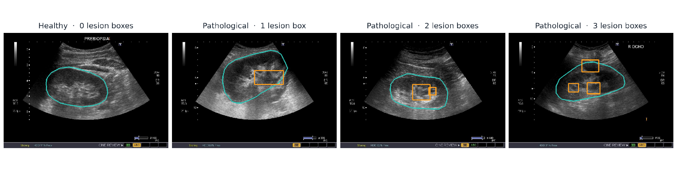
URI-CADS Renal Ultrasound Dataset
A public, peer-reviewed benchmark with pixel-level kidney masks and bounding-box lesion annotations.
There were a total of 1985 annotated images and 450 of them showcased anomalies , there were a total of 9 different classes, furthermore we had 2 global values saying if an anomaly existed or not, we also conducted a 70/15/15 split on the train test and validation sets.
4

Slide 5
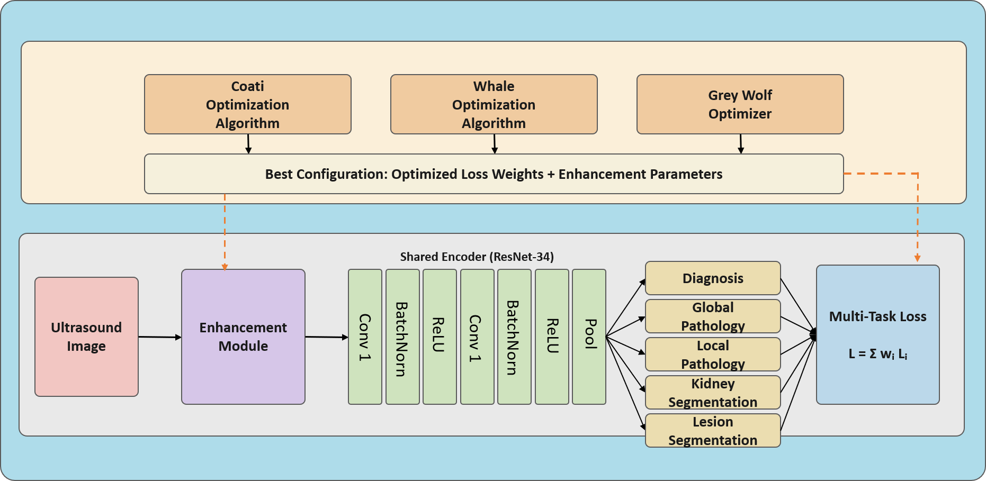
End-to-End Framework - 1
One shared encoder, five task heads, and an optimizer that tunes both the enhancement and the loss weights.
5

Slide 6
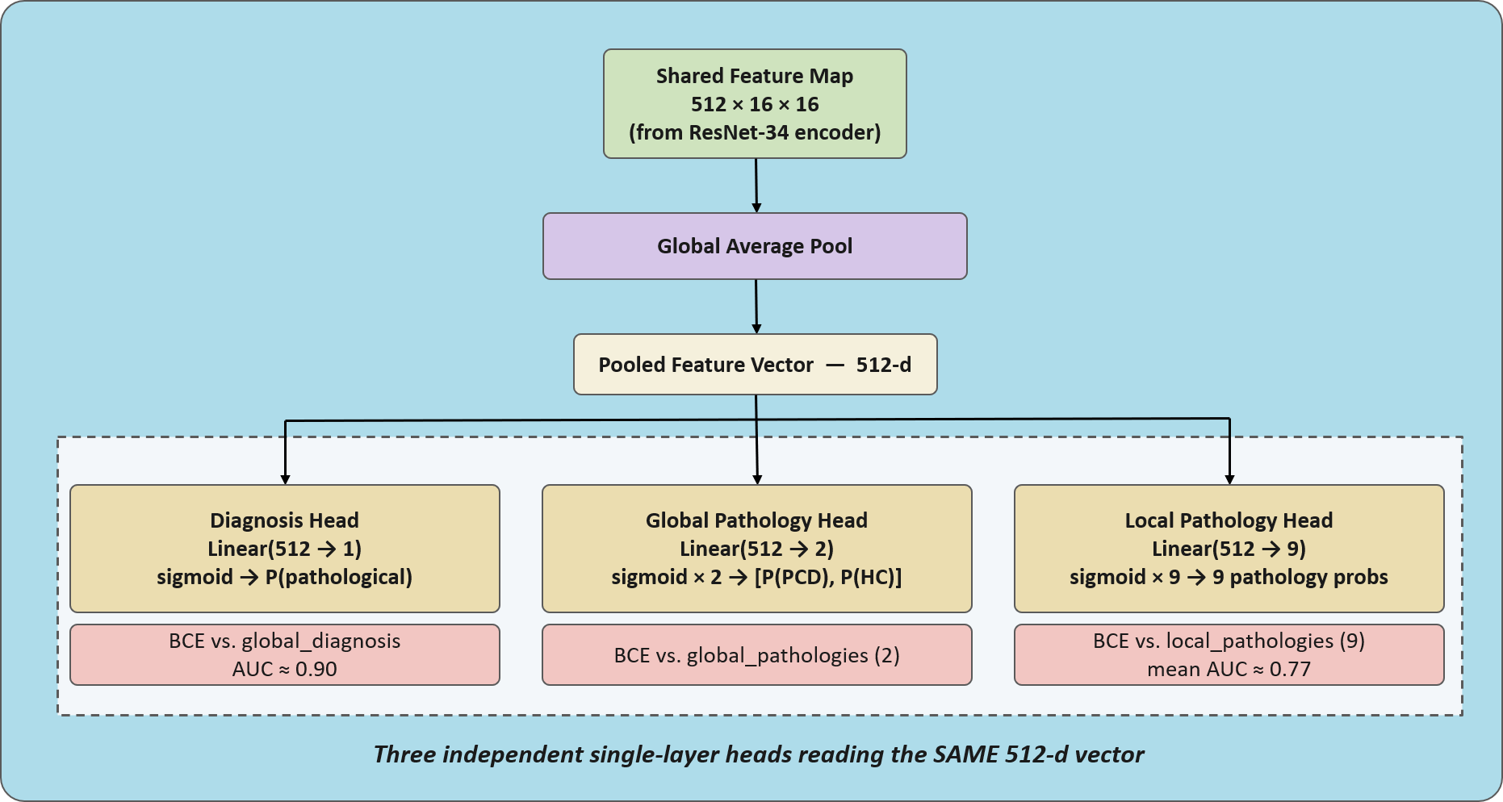
End-to-End Framework - 2
Head 1 - Diagnosis Head; Head 2 - Global Pathology Head; Head 3 - Local Pathology Head
4

Slide 7
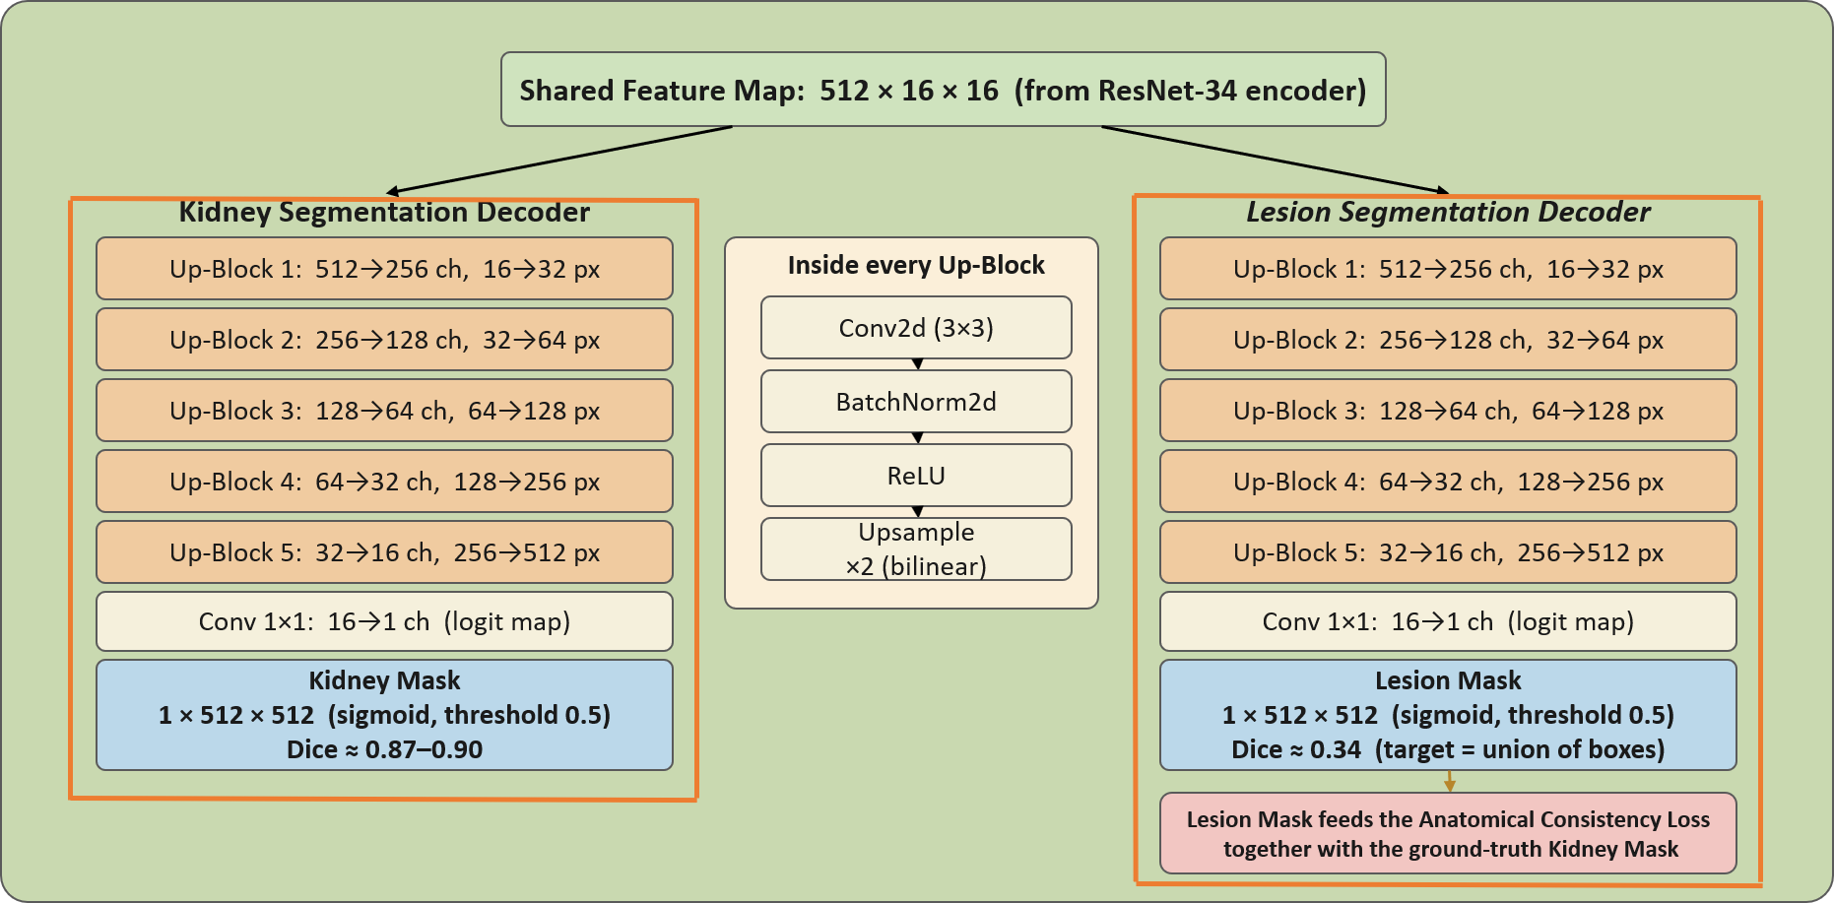
End-to-End Framework - 3
Head 4 - Kidney Segmentation Head; Head 5 - Lesion Segmentation Head
4

Slide 8
Architecture: Five Heads on One Encoder
Head | Output | Loss | Phase
Diagnosis | 1 logit: healthy vs pathological | Binary cross-entropy | 2
Global pathology | 1 logit: PCD, HC (multi-label) | Binary cross-entropy | 2
Local pathology | 9 logits, one per lesion category | Binary cross-entropy | 4
Kidney segmentation | 512x512 mask, 5-stage upsampling decoder | Dice loss | 2
Lesion segmentation | 512x512 mask of the lesion-box union | Dice loss | 4
Anatomical consistency | Lesion probability outside the kidney | Ratio penalty between outside and total | 5
No Mask R-CNN, Faster R-CNN or U-Net: every head reads the same encoder feature map.
the entire model of 24.4 million parameters in total trains in 0.81 GB of GPU memory.
6

Slide 9
Loss Design and the Anatomical Constraint (troubleshoot)
Multi-task objective loss function:
L = w1·L_diag + w2·L_global + w3·L_local + w4·L_kidney + w5·L_lesion + w6·L_anat
Phases 2–5: every weight w = 1, the unweighted sum used by URI-CADS (fair baseline).
Phase 6: each weight searched in [0.1, 5.0].
Trouble shooting the anatomical-consistency fix:
First version penalized the absolute amount of lesion probability outside the kidney : which was lowerable just by predicting less lesion everywhere.
Corrected version penalizes the fraction (ratio) of lesion probability outside the kidney : which can only improve by moving predictions inside the kidney.
7

Slide 10
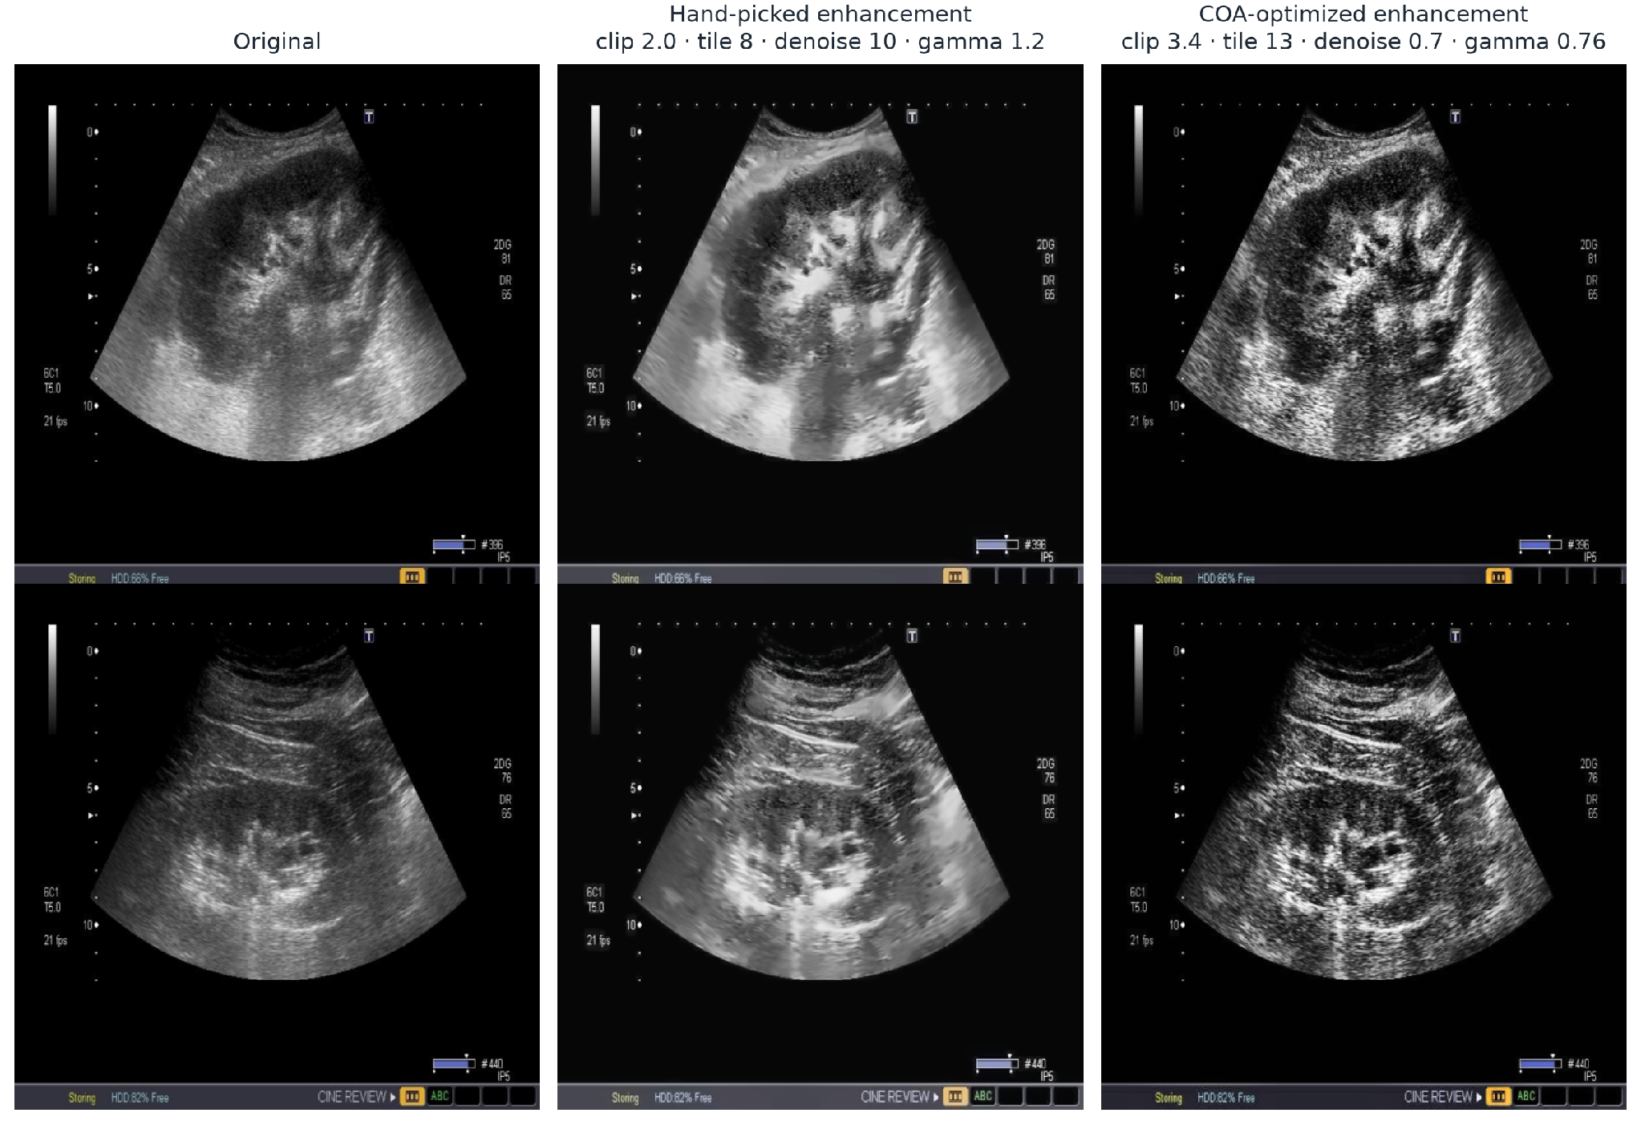
Image Enhancement Layer
preprocessing parameters: CLAHE clip limit, tile grid size, non-local-means denoising strength, and gamma.
Enhanced images are computed once per configuration across 12 CPU workers and reused for every epoch (denoising costs ~0.6s/image).
8

Slide 11
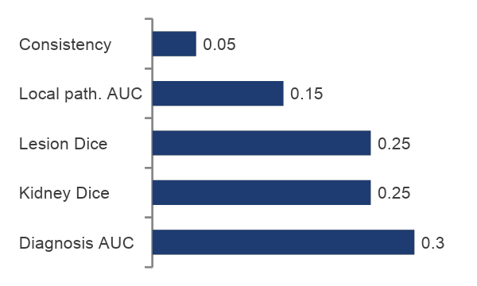
How the Search Is Set Up
10 parameters
6 loss weights in [0.1, 5.0] and 4 enhancement settings were searched jointly.
Equal budget
60 model trainings per metaheuristic optimization model, 180 in total capped on trainings rather than iterations.
Evaluation
Each candidate trained 15 epochs at 256x256 (around 2 minutes), then scored on validation.
Common start
Same random seed: all optimizers begin from the same 6 candidates.
Fitness (maximized on validation)
F =
0.30·AUC_diag +
0.15·AUC_local + 0.25·Dice_kidney + 0.25·Dice_lesion+ + 0.05·(1−violation)
9

Slide 12
Three Metaheuristics Algorithms Compared
COA
Coati Optimization Algorithm
Half the population moves toward the best solution, half toward a random point; then a local search with a radius that shrinks each iteration.
WOA
Whale Optimization Algorithm
Encircles the best solution, explores via random agents, and exploits with a spiral update, step size shrinks over time.
GWO
Grey Wolf Optimizer
Moves every candidate toward the three best solutions so far (alpha, beta, delta); exploration shrinks linearly.
10

Slide 13
Protocol and Reproducibility Check
For reproducibility we tested the same pipeline in both an online colab notebook as well as our local system
Training protocol, identical for every phase
Split 70/15/15, stratified by diagnosis, seed 42.
15 epochs, batch 4, Adam, learning rate 1e-4.
Mixed precision; best checkpoint chosen on validation Dice.
Input 512x512, standard normalization to [-1, 1].
Hardware: RTX 3050 Laptop GPU, 4GB.
Checkpoint | Metric | Orig. | New
Phase 2 | Diagnosis AUC | 0.9003 | 0.9001
Phase 2 | Kidney Dice | 0.8735 | 0.8733
Phase 3 | Diagnosis AUC | 0.8712 | 0.8707
Phase 4 | Local path. AUC | 0.7724 | 0.7723
Phase 5 | Violation rate | 0.3790 | 0.3786
Metrics used throughout:
AUC - ranking quality, 0.5 is chance. Dice - overlap, 1 is perfect. Violation rate - share of lesion probability outside the kidney, lower is better.
11

Slide 14
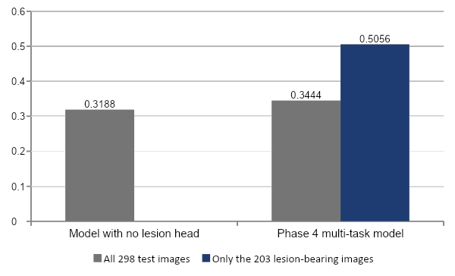
The Standard Lesion Dice Was Hiding Real Performance
Lesion Dice on the test set
31.9% of test images contain no lesion; an empty prediction scores about 1 on each of them.
Restricting to lesion-bearing images separates the models clearly: 0.000 vs 0.506.
We now report both versions of lesion Dice.
The optimizer uses the lesion-bearing version only, so it cannot be rewarded for predicting nothing.
12

Slide 15
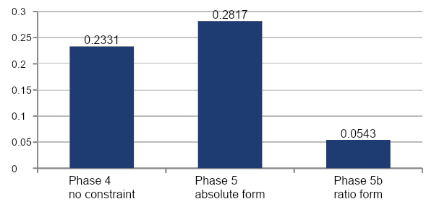
The Anatomical Constraint Works Only in Ratio Form
Violation rate on the test set (lower is better)
Test metric | P4 | P5 | P5b
Violation rate | 0.233 | 0.282 | 0.054
Diagnosis AUC | 0.900 | 0.879 | 0.901
Kidney Dice | 0.893 | 0.884 | 0.895
Lesion Dice (lesion imgs) | 0.506 | 0.487 | 0.488
13

Slide 16
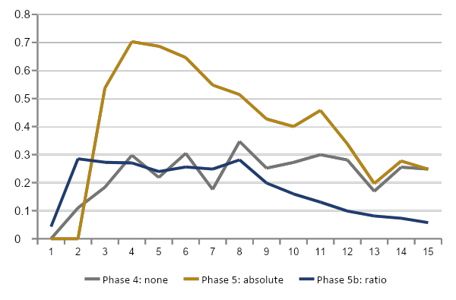
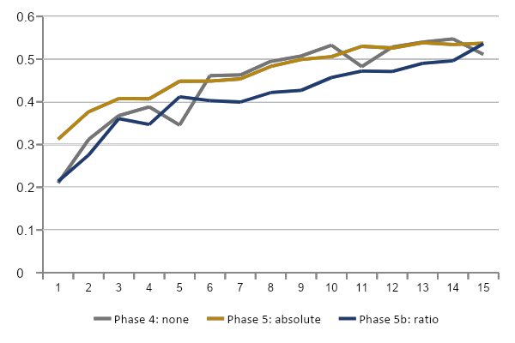
How the Constraint Acts During Training
Validation violation rate by epoch (lower is better)
Validation lesion Dice on lesion-bearing images by epoch
(higher is better)
The absolute form (amber) spikes to ~0.70 at epoch 4 and only recovers to the unconstrained level by the end.
The ratio form (navy) holds around 0.25 for the first eight epochs, then falls steadily to 0.058 at epoch 15.
Lesion Dice on lesion-bearing images climbs along a similar path for all three, matching the small cost seen on the previous slide.
14

Slide 17
All Configurations on the Same Test Set
Ph. | Configuration | Diag. AUC | Global AUC | Local AUC | Kidney Dice | Lesion Dice (all) | Lesion Dice (lesion imgs) | Viol. rate
2 | Equal weights, no enhancement | 0.9013 | 0.8038 | — | 0.8991 | — | — | —
3 | Hand-picked enhancement | 0.8903 | 0.7802 | — | 0.9021 | — | — | —
4 | Five heads, no constraint | 0.8995 | 0.8012 | 0.7704 | 0.8928 | 0.3444 | 0.5056 | 0.2331
5 | Constraint, absolute form | 0.8791 | 0.8004 | 0.7752 | 0.8838 | 0.3518 | 0.4868 | 0.2817
5b | Constraint, ratio form | 0.9014 | 0.7932 | 0.7416 | 0.8954 | 0.3325 | 0.4881 | 0.0543
6 | COA-optimized weights + enhancement | 0.8753 | 0.7255 | 0.7314 | 0.9081 | 0.2847 | 0.4180 | 0.0545
15

Slide 18
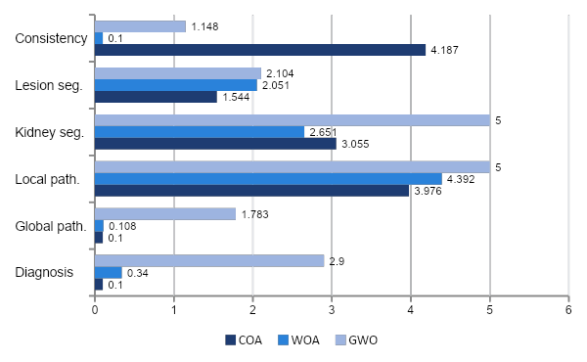
What the Optimizers Chose
Loss weights found by each optimizer (baseline: all weights = 1.0)
Enhancement parameters chosen
 | Clip | Tile | Denoise | Gamma
Manual | 2.00 | 8 | 10.0 | 1.20
COA | 3.40 | 13 | 0.7 | 0.76
WOA | 2.57 | 16 | 1.9 | 0.79
GWO | 5.00 | 10 | 9.3 | 0.54
All three: gamma below 1 and a larger tile grid than hand-picked.
COA and WOA: denoising nearly off.
COA and WOA: diagnosis weight near the 0.1 floor; GWO keeps it at 2.9.
16

Slide 19
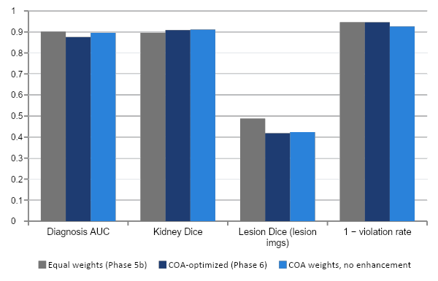
Does the Optimized Configuration Hold Up?
Full-fidelity test results (15 epochs, 512x512) — COA-optimized vs equal weights
+0.013 kidney Dice
−0.026 diagnosis AUC
−0.070 lesion Dice (lesion images)
17

Slide 20
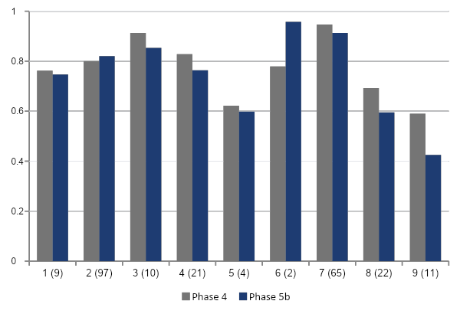
Per-Category Performance and Its Limits
Local pathology AUC by category (test images with that category shown in labels)
How to read this
AUC 0.5 is chance level.
Common categories 2 and 7 (97 and 65 test images) are strong.
Categories 8 and 9 are weakest.
Categories 5 and 6 have only 4 and 2 test images, their AUCs are not reliable.
We report per-category counts alongside the mean.
19

